Slide 1
Study Group
#2: back propagation
Aka ur network learns:)
Speaker: Lindy Zhai, Mindy Lee
University of Toronto Machine Intelligence Team

Slide 2
What to expect?
Recap
Quizzes (Q&A)
Assignment Q examples
General Q&A sessions
Notes:
This is the first session so we will take it easy and go through some details regarding the curriculums and what is coming next. But I can assure you the following sessions are going to be far more interesting and you can expect a lot of extra fun details that was not included in the lectures.

Slide 3
Recap;
Notes:
This is the first session so we will take it easy and go through some details regarding the curriculums and what is coming next. But I can assure you the following sessions are going to be far more interesting and you can expect a lot of extra fun details that was not included in the lectures.

Slide 4
Deep Learning;
Machine Learning:
AI that automatically adapt with minimal human interface.
Then what’s deep learning?
Neural Networks
Notes:
In short, machine learning is AI that can automatically adapt with minimal human interference.

Slide 5
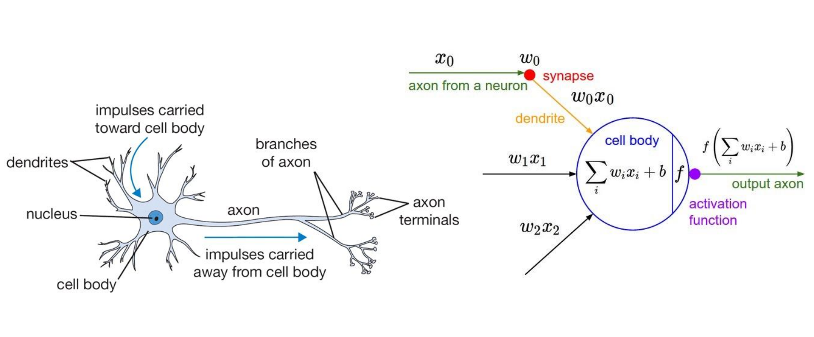
Neurons;
Notes:
This is the first session so we will take it easy and go through some details regarding the curriculums and what is coming next. But I can assure you the following sessions are going to be far more interesting and you can expect a lot of extra fun details that was not included in the lectures.

Slide 6
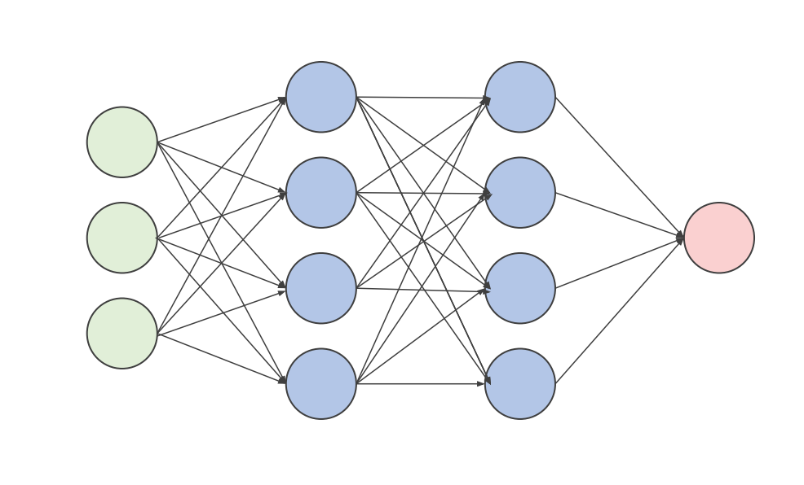
Perceptrons;
Notes:
To deal with the linearly inseparable cases

Slide 7
Continue;
Notes:
This is the first session so we will take it easy and go through some details regarding the curriculums and what is coming next. But I can assure you the following sessions are going to be far more interesting and you can expect a lot of extra fun details that was not included in the lectures.

Slide 8
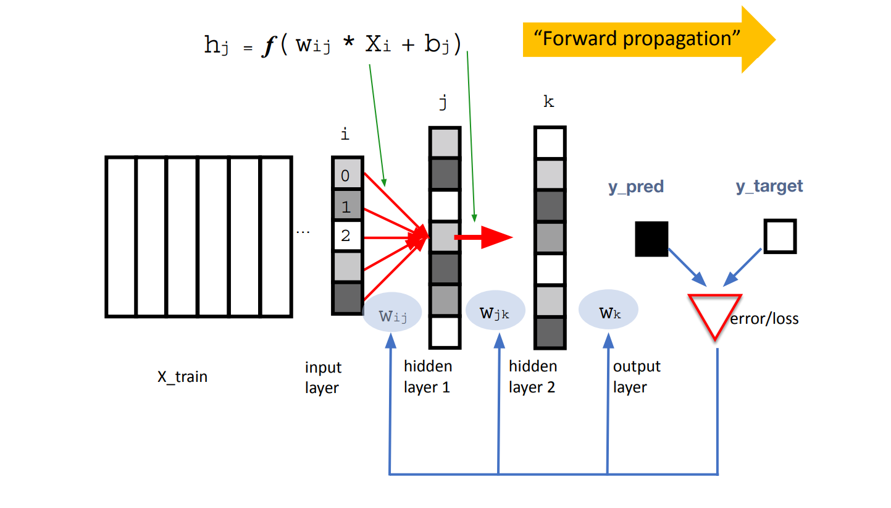
Forward_passing;
Notes:
This is the first session so we will take it easy and go through some details regarding the curriculums and what is coming next. But I can assure you the following sessions are going to be far more interesting and you can expect a lot of extra fun details that was not included in the lectures.

Slide 9
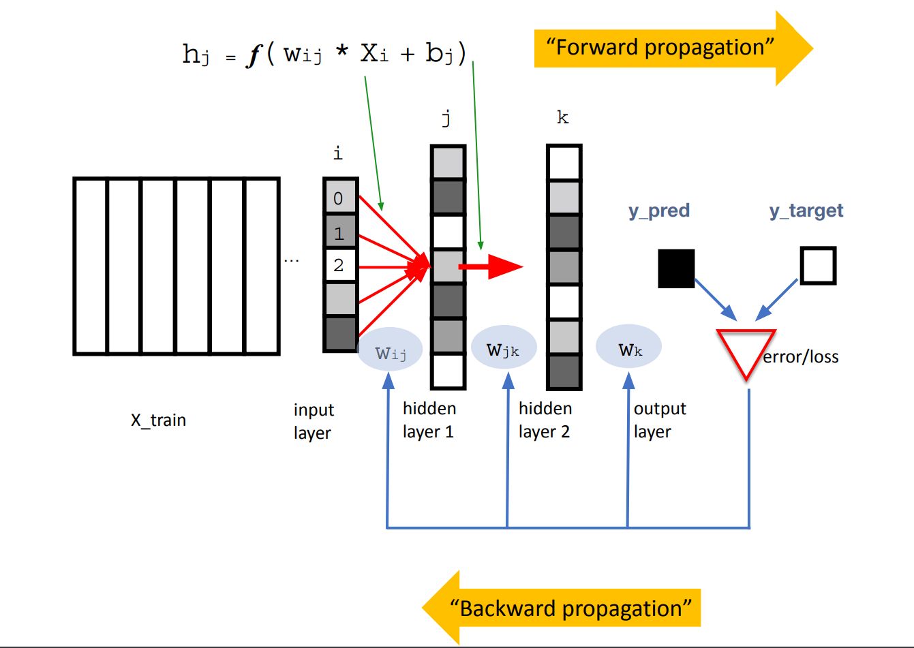
Backward_passing (back_propagation);
Notes:
This is the first session so we will take it easy and go through some details regarding the curriculums and what is coming next. But I can assure you the following sessions are going to be far more interesting and you can expect a lot of extra fun details that was not included in the lectures.

Slide 10

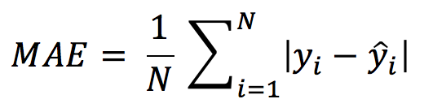
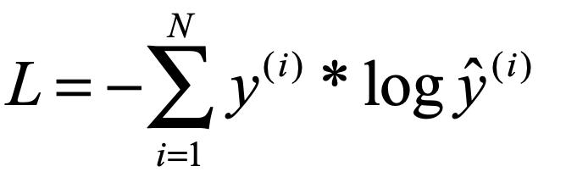

Loss_fcn;
Notes:
This is the first session so we will take it easy and go through some details regarding the curriculums and what is coming next. But I can assure you the following sessions are going to be far more interesting and you can expect a lot of extra fun details that was not included in the lectures.

Slide 11
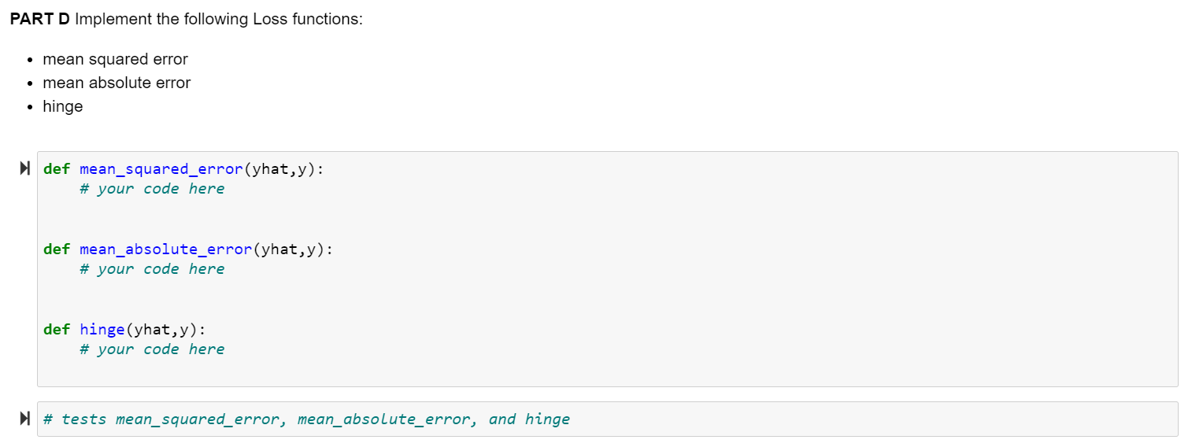
Loss_fcn (Assignment_Q2(D));
Notes:
This is the first session so we will take it easy and go through some details regarding the curriculums and what is coming next. But I can assure you the following sessions are going to be far more interesting and you can expect a lot of extra fun details that was not included in the lectures.

Slide 12
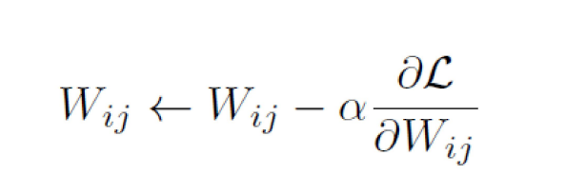
Backward_passing (back_propagation);
Notes:
This is the first session so we will take it easy and go through some details regarding the curriculums and what is coming next. But I can assure you the following sessions are going to be far more interesting and you can expect a lot of extra fun details that was not included in the lectures.

Slide 13
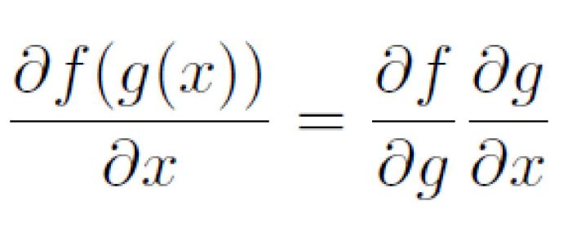
Chain_rules;
Notes:
This is the first session so we will take it easy and go through some details regarding the curriculums and what is coming next. But I can assure you the following sessions are going to be far more interesting and you can expect a lot of extra fun details that was not included in the lectures.

Slide 14
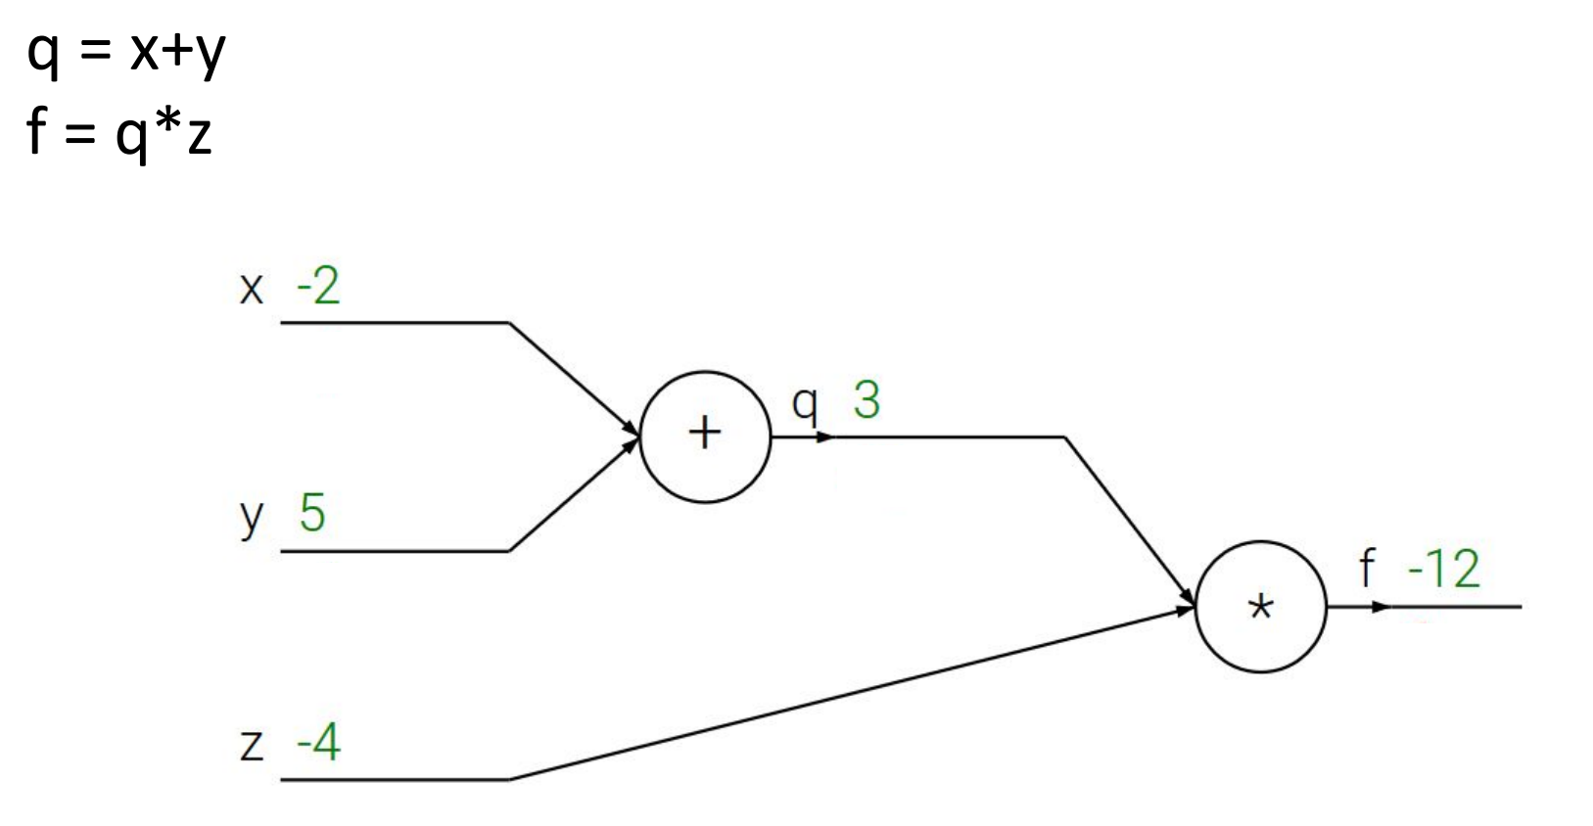
Computation_graph;
Notes:
This is the first session so we will take it easy and go through some details regarding the curriculums and what is coming next. But I can assure you the following sessions are going to be far more interesting and you can expect a lot of extra fun details that was not included in the lectures.

Slide 15
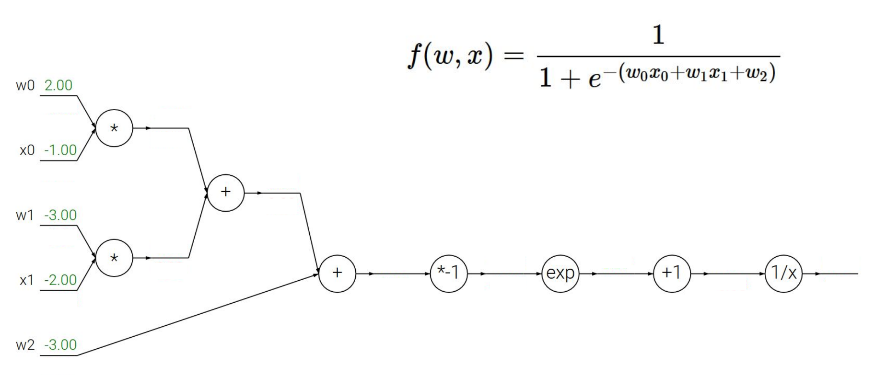
Computation_graph;
Notes:
This is the first session so we will take it easy and go through some details regarding the curriculums and what is coming next. But I can assure you the following sessions are going to be far more interesting and you can expect a lot of extra fun details that was not included in the lectures.

Slide 16
Quiz!!!!!
Notes:
This is the first session so we will take it easy and go through some details regarding the curriculums and what is coming next. But I can assure you the following sessions are going to be far more interesting and you can expect a lot of extra fun details that was not included in the lectures.

Slide 17
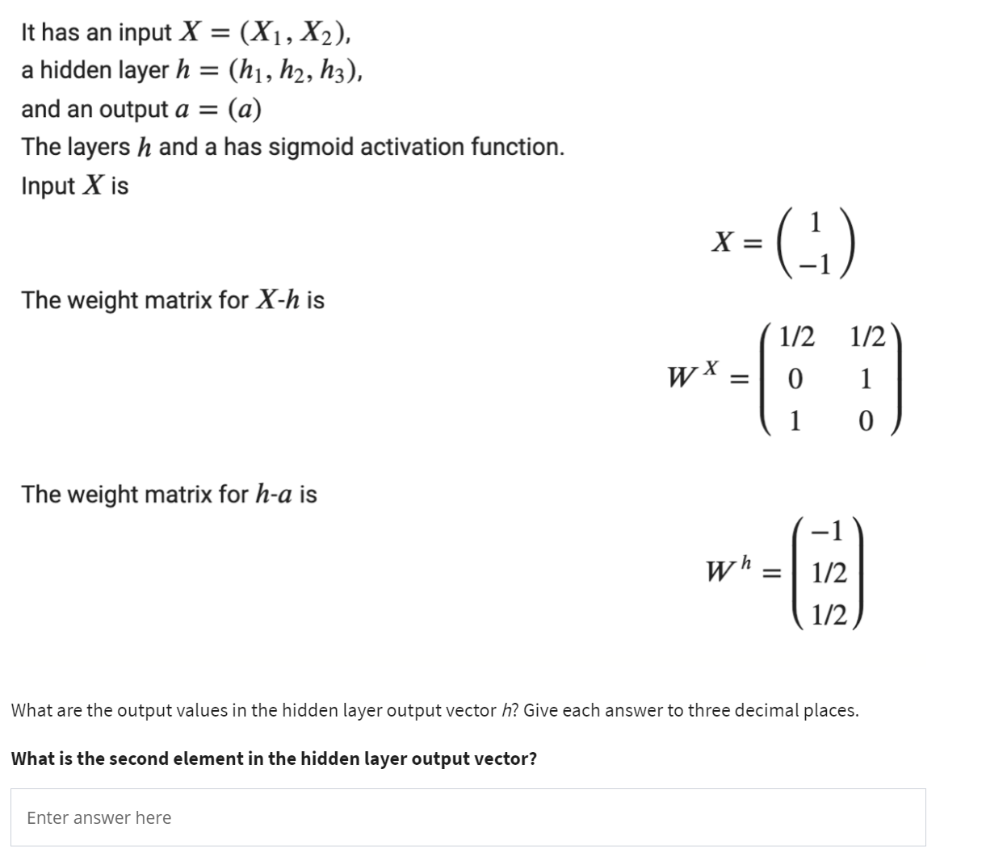
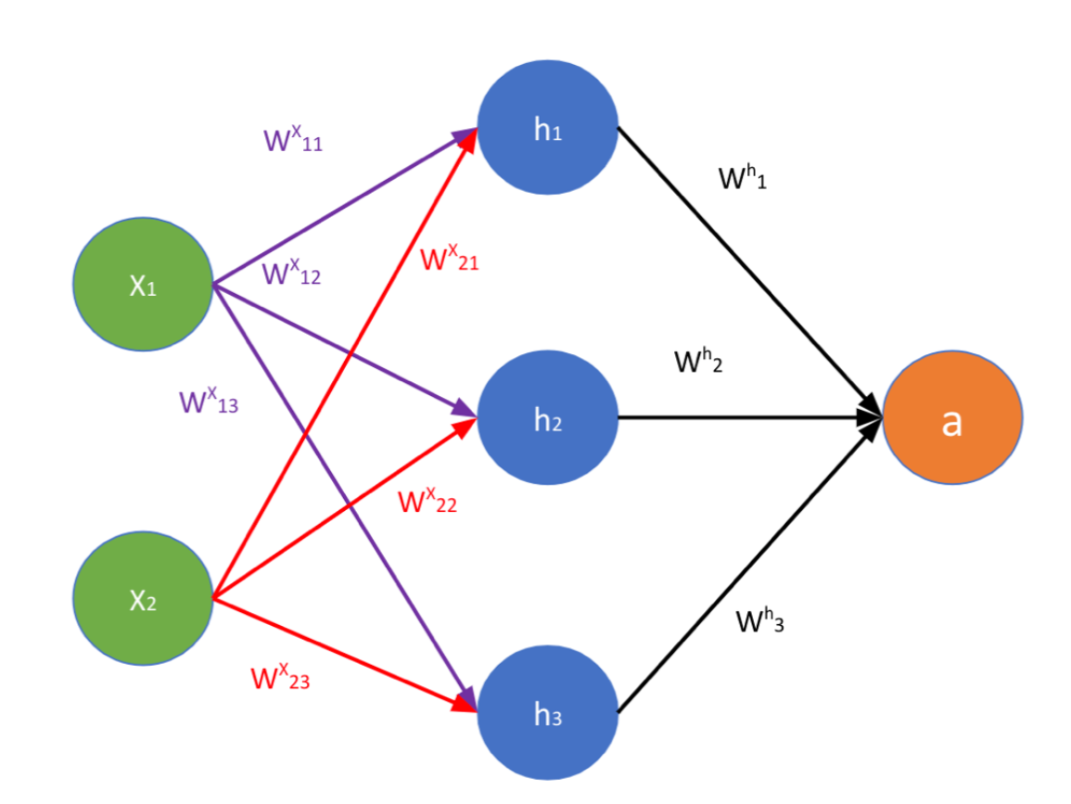
Quiz_Wee_1_#2;
Notes:
This is the first session so we will take it easy and go through some details regarding the curriculums and what is coming next. But I can assure you the following sessions are going to be far more interesting and you can expect a lot of extra fun details that was not included in the lectures.

Slide 18
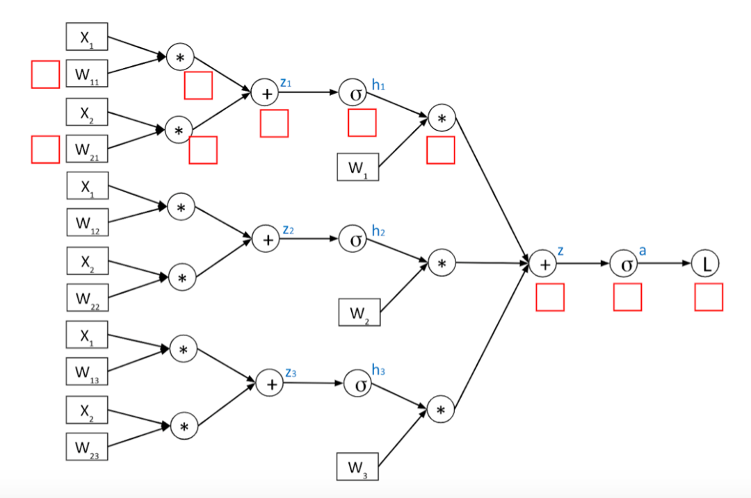
Quiz_Wee_1_#2;
Notes:
This is the first session so we will take it easy and go through some details regarding the curriculums and what is coming next. But I can assure you the following sessions are going to be far more interesting and you can expect a lot of extra fun details that was not included in the lectures.

Slide 19
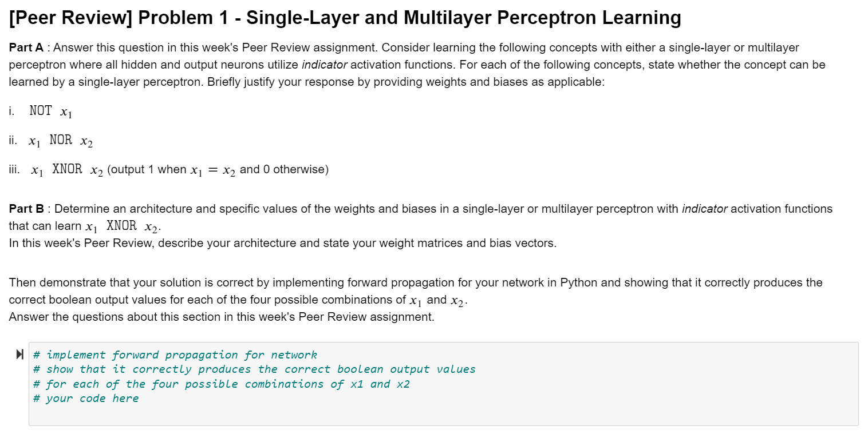
Assignment_Q1
Notes:
This is the first session so we will take it easy and go through some details regarding the curriculums and what is coming next. But I can assure you the following sessions are going to be far more interesting and you can expect a lot of extra fun details that was not included in the lectures.

Slide 20
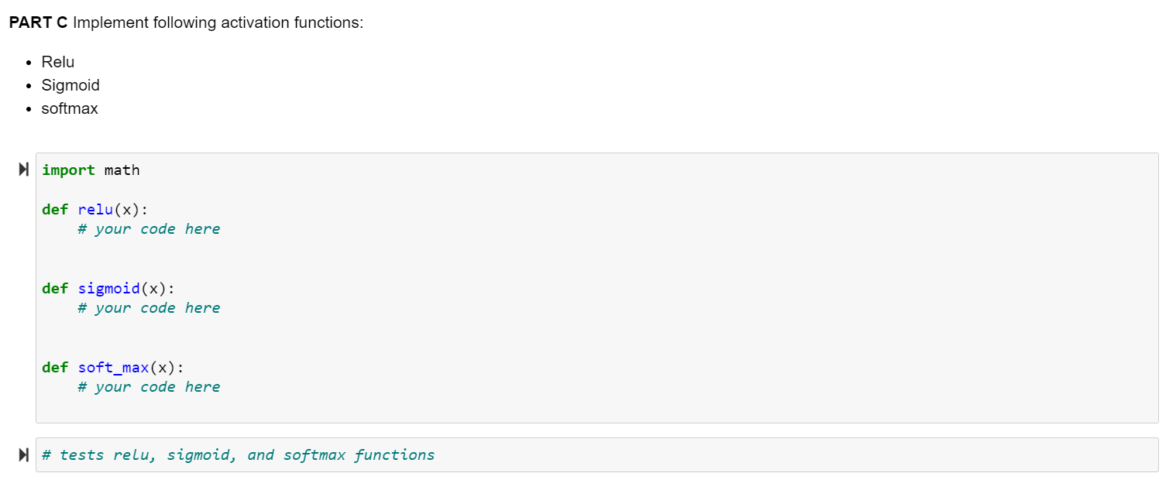
Assignment_Q2(C)
Notes:
This is the first session so we will take it easy and go through some details regarding the curriculums and what is coming next. But I can assure you the following sessions are going to be far more interesting and you can expect a lot of extra fun details that was not included in the lectures.

Slide 21
Next Session;
TRAINING!!!
Training structures
Hyperparameters
Regularizations
Less math, more codes
Notes:
This is the first session so we will take it easy and go through some details regarding the curriculums and what is coming next. But I can assure you the following sessions are going to be far more interesting and you can expect a lot of extra fun details that was not included in the lectures.

